Slide 1

“Bismillahir Rahmanir Rahim”
Design and Implementation of a SCADA-Based Boiler Monitoring and Controlling System
Supervised By:
Engr. Md. Rashidul Islam
Associate Professor,
Department of Electrical and Electronic Engineering International Islamic University Chittagong.
Presented By:
Md. Khaled Hossain Jahin (ID. ET191055)
Muaz Muhammad (ID. ET191064)

Slide 2
Presentation Outline
Introduction
Background
Literature Review
Problem Statement
Objectives
Methodology
Block Diagram
Flow Chart
Circuit Diagram
Simulation
Experimental Implementation
Result & Discussion
Advantage & Application
Cost Analysis
Limitation
Future Work
Comparative Study
Conclusion
Reference

Slide 3
Introduction
Boilers are essential in industrial settings, providing heat and steam for various applications, necessitating efficient operation and robust control mechanisms to ensure effectiveness.
Our project addresses the need for automation and reduced human intervention in power plants and industrial operations by leveraging SCADA technology.
Our project explores the theoretical foundations of using PLC and SCADA systems to monitor, record, and control boiler processes, translating theory into practical application.
The project uses a PLC to control boiler temperature, pressure, and water levels and a SCADA system for data visualization and control.
With sensors measuring pressure, temperature, and water levels, the proposed automation system aims to enhance safety, reliability, and uninterrupted operation in power generation facilities, setting the stage for future advancements in industrial automation.

Slide 4
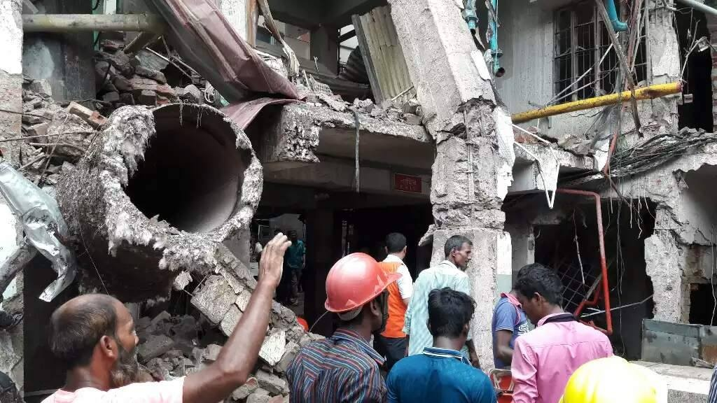
Background
Boilers are utilized in many industrial applications, and accidents like boiler explosions make safe operation essential.
The suppression of combustion causes boiler explosions, which can be internal or exterior.
Historical incidents like The 1986 Chernobyl Nuclear Power Plant explosion and 1988 Piper Alpha accident demonstrate the dangers of boiler failures and the significance of safety and control.
Recent boiler explosions, such as those in Bangladeshi textile factories in 2017 and 2018, resulted in multiple fatalities and injuries, emphasizing the urgent need for robust monitoring and control systems.
Fig. 01: Boiler explosion Gazipur 2017

Slide 5
Literature Review
Paper Name | Autor | Contribution | Limitation
Embedded system Based Laboratory Thawing Path Boiler Automation Using GSM Technology [1] | T.Karuppiah, Dr.Azha Periasamy | Offers a fundamental structure for automating and remotely monitoring boilers, while the capacity to handle bigger systems may be limited by scalability and network stability. | Constraints include restricted scalability, reliance on GSM networks, limited resilience to faults, and potential complications in integrating with current systems.
Boiler automation using embedded system [2] | Mohana Priya R, Sowmiya K, Tharani K, Smitha M | Provides a straightforward method for remotely monitoring boiler parameters but does not include extensive control functionalities or the potential to scale up. | The system has a restricted range of capabilities beyond basic monitoring and alerting, and it lacks a centralized control interface.
Design and Implementation of Boiler Automation System Using PLC[3] | S.M Tahsin Labib, Sohanul Alam, Shafayet Hossain, MD.Iquebal Hossain Patwary | Provides support for fundamental automation functions, but does not provide advanced control logic or scalability. | Limited automation possibilities, dependence on manual intervention for specific processes
Smart System for Boiler Automation[4] | Rashmi Welekar | The system employs the cost-effective Arduino platform to monitor temperature, provide warnings, and maintain exact temperature control. | Industrial applications may have limitations in terms of adaptability, and there is a possibility of accuracy concerns with LM35 sensors.
Controlling and Monitoring of Boiler Parameters using Scada [5] | Vidhyalakhshmi P, Dhanishka.k.V, Gokulapriya.P, Vasant.S | Provides sophisticated management and monitoring features but necessitates meticulous implementation to minimize security vulnerabilities and guarantee dependability. | The installation is intricate, with the possibility of cybersecurity risks. It may require a substantial initial cost for setup.
May 24, 2024
5

Slide 6
Problem Statement
Many industrial boiler systems rely on manual monitoring and control methods, leading to inefficiencies, safety risks, and increased operational costs due to human error and delayed response times.
Traditional boiler systems cannot assess real-time data on water level, temperature, and steam pressure, making proactive decision-making and preventive maintenance difficult.
Automated monitoring and control systems reduce manual intervention-related boiler explosions, equipment failures, and environmental damage.
Without automated systems, industrial boilers may function inefficiently, wasting fuel, energy, and the environment. Advanced control solutions are needed.

Slide 7
Objectives
To develop SCADA system for real-time monitoring and control of boiler system.
To provide historical data logging and reporting capabilities for analysis and maintenance.
To improve operational efficiency by automating pressure, temperature, water level and enhancing safety by preventing accidents and system failures of the boiler system.

Slide 8
Methodology
The process initiates with the activation of the PLC and SCADA systems, establishing the foundation for monitoring and control operations.
To ensure measurement accuracy and dependability, water level, temperature, and steam pressure sensors are examined using required values and calibrated separately.
Based on the parameter evaluations (high, medium, or low), automated actions are triggered, such as activating or deactivating the pump motor, burner, or safety valve to maintain optimal operating conditions and ensure safety.
All data on system parameters is stored in the SCADA system for analysis and monitoring after careful adjustment to ensure measurement precision. SCADA may also initiate and stop processes for seamless operation and supervision.

Slide 9
Methodology (Cont.)
Block Diagram
Temperature
Sensor
Pressure Sensor
Level Sensor
Start
Switch
PROGRAMMABLE LOGIC CONTROL
INPUT
SCADA
OUTPUT
Stop
Switch
Feed Pump On/Off
Burner
On/ Off
Steam Outlet
Alarm
BOILER
Fig. 02: Block Diagram

Slide 10
Methodology (Cont.)
Flow Chart
Start
PLC
SCADA
Compare the Preset Value
Water Level Check
Temperature Check
Steam Pressure Check
Value
Calibrate
Value
Calibrate
Value
Calibrate
High
Low
Medium
High
LOW
High
Low
Pump Motor Off
Pump Motor ON
Pump Motor ON
Burner ON
Safety Bulb ON
Safety Bulb Off
System Trip and Alarm
Fig. 03: Flow Chart

Slide 11
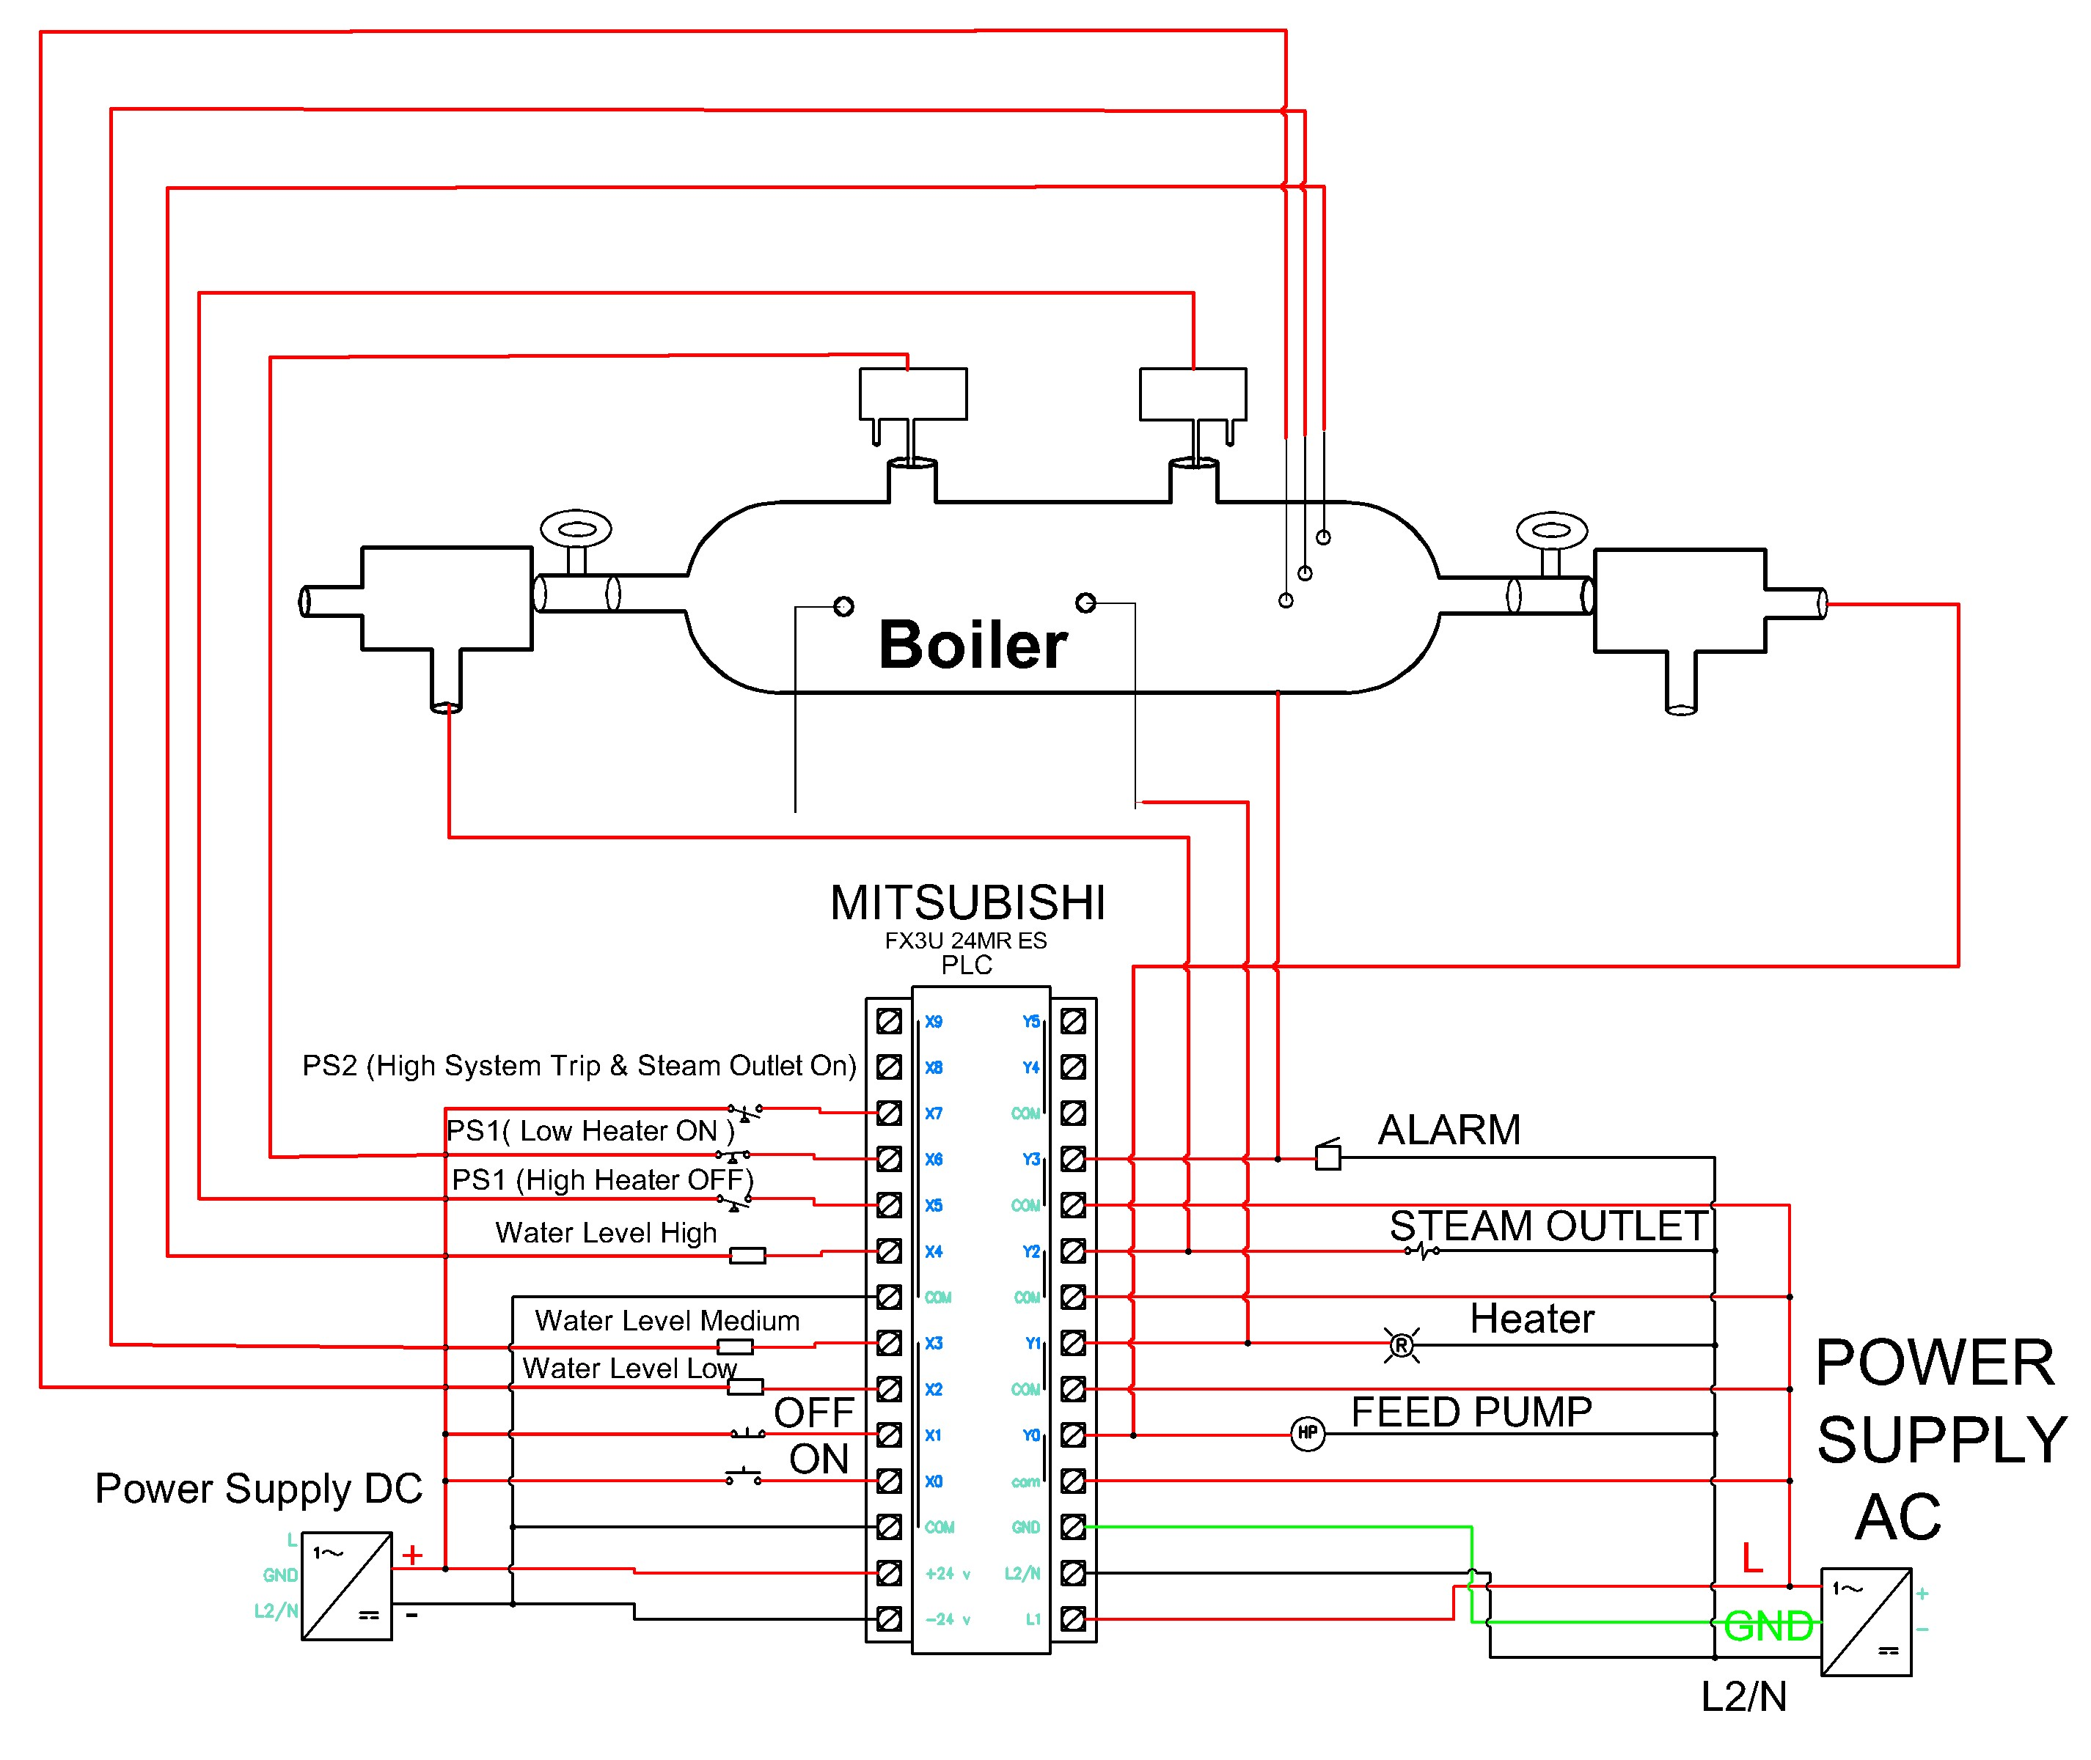
Circuit Diagram
Methodology (Cont.)
Fig. 04: Circuit diagram of the boiler system using

Slide 12
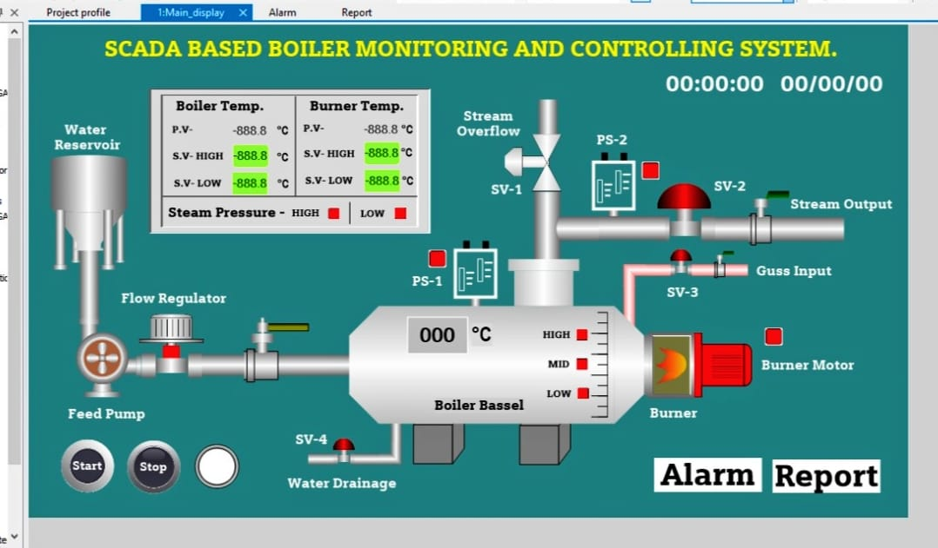
Simulation
Methodology (Cont.)
Fig. 05: Simulation of the boiler system using

Slide 13
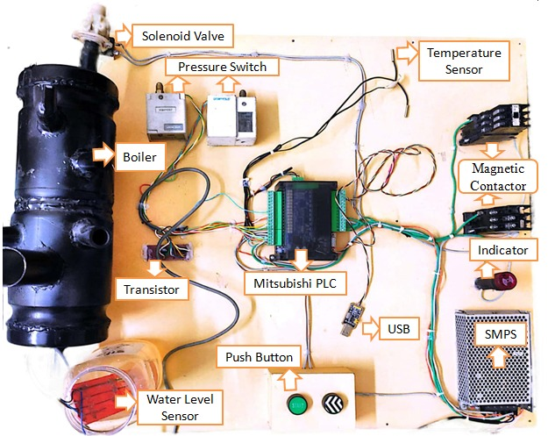


Experimental Implementation
Fig. 06: System Hardware Overview

Slide 14
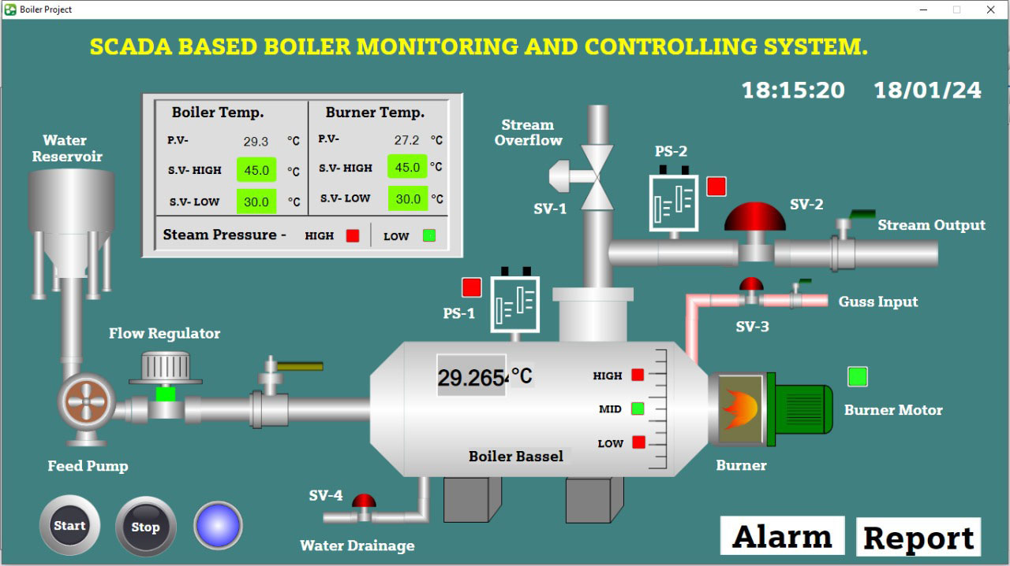
Result And Discussion
The SCADA system activates the burner when the temperature reaches or falls below 30℃ , initiating the boiler start-up sequence.
The boiler is filled with water, and the burner is activated to commence heating for steam generation.
Despite activation, the system detects insufficient steam pressure, necessitating further investigation and corrective measures to ensure optimal boiler performance.
Fig. 07: Initial state System

Slide 15

Result And Discussion
The SCADA system triggers the boiler's operation when the temperature surpasses 30℃ .
When the boiler is turned on, the water inside begins to boil, which is an important part of the process of producing steam.
As the water boils, steam pressure within the boiler rises, facilitating the generation of steam for industrial processes.
Fig. 08: Operational state of system

Slide 16

Result And Discussion
The system triggers shutdown procedures when the temperature surpasses 45°C , resulting in the termination of burner operation and an increase in steam levels.
The device automatically switches off the burner when the water level drops, protecting users from any harm and hazards that could arise from low water levels.
High steam levels trigger shutdowns, reducing pressure risks and protecting the boiler system and infrastructure.
Fig. 09: Shutdown state of system

Slide 17
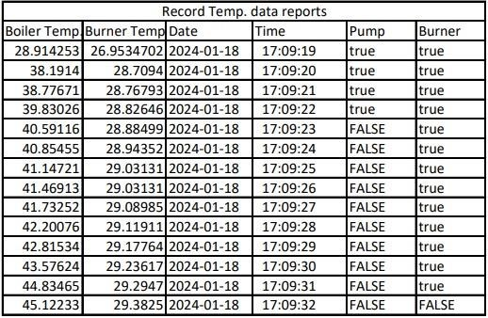
Result And Discussion
Fig. 10: Real-Time data of system

Slide 18
Advantage and Application
Advantage | Application
Enhanced Efficiency and improved Safety of the system. Operators can monitor and control the boiler remotely through the HMI. Data visualization, data Analysis and historical data logging of boilers. User-Friendly Interface and Alarm Handling to the system. By preventing equipment failures, optimizing operations, and reducing downtime, the system can lead to substantial cost savings over time. | This device can be used to digitalize industries. It's possible for improving management level and high efficiency prices. This device may be utilized to regulate and oversee the temperature and pressure of many boilers simultaneously. Applicable in both small and big industries

Slide 19
COST ANALYSIS
SL. No | Components Name | Quantity | Price (BDT)
1 | Mitsubishi FX3U-24MRES PLC | 01 Pcs | 12000/-
2 | Temperature sensor | 02 Pcs | 200/-
3 | Pressure switch | 02 Pcs | 1000/-
4 | Solenoid valve | 01 Pcs | 500/-
5 | SMPS | 01 Pcs | 500/-
6 | Water level sensor | 01 Pcs | 150-
7 | Magnetic contactor | 02 Pcs | 2000/-
8 | Others | ----- | 1000/-
 |  | Total | 17350/-

Slide 20
Limitation
Designing and configuring a SCADA system can be complex and time-consuming.
SCADA systems require regular maintenance to ensure their reliability.
Customization Complexity and compatibility with Legacy Systems

Slide 21
Future Work
Our project commits to ongoing enhancements of the SCADA system, ensuring its relevance and effectiveness in the ever-evolving field of automation.
By adopting predictive maintenance techniques, the system enables early detection of equipment breakdowns, minimizing costly downtime periods and enhancing overall reliability.
Sophisticated analytics on our project , such as machine learning algorithms and remote diagnostics, optimize boiler performance and reduce inefficiencies, providing operators with real-time insights for improved response times and adaptability..

Slide 22
Comparative Study
Boiler system | Features | Safety | Cost | Effectiveness
Traditional manual control boiler systems | Simplified pressure and temperature monitoring with manual controls and reliance on human operator | Minimal safety measures, higher probability of accidents and human error | Lowest initial cost | Limited
PLC-Based Boiler Automation system[3] | System utilizes automated control logic, but its scalability is restricted and operates via ON-OFF control | Automation offers safety but is prone to programming errors | High initial cost | Moderated
SCADA-based Boiler Monitoring and Controlling System (proposed work) | Enhanced analytics, remote access, centralized monitoring, and real-time data acquisition | Improved safety measures, real-time tracking for fast identification of faults | Highest initial cost | High

Slide 23
Conclusion
The project successfully integrates SCADA technology with PLC to manage boiler systems effectively, ensuring improved safety precautions, efficient control mechanisms, and real-time monitoring capabilities.
The implemented system meets industrial needs by providing long-term durability, high efficiency, and improved boiler safety, improving on earlier methods.
The project improves industrial boiler efficiency, safety, and flexibility by overcoming prior boiler control methods, benefiting companies seeking automation solutions.
Despite being more expensive, the project responds faster and is safer and more adaptable than manual control. Boilers may be fully automated with this technology, helping companies become digital.

Slide 24
Reference
[1] T. Karuppiah and Dr. Azha. Periasamy, "Embedded System Based Laboratory Thawing Path Boiler Automation Using GSM Technology," International Journal of Advanced Research in Computer and Communication Engineering, Vol. 5, pp,139-142,2018
[2] Mohana Priya R, Sowmiya K, Tharani K, Smitha M, “Boiler automation using embedded system”, International Journal of Advance Research and Innovative Ideas in Education, Vol.9, pp,4378-4382 2023.
[3] S. M. Tahsin Labib, Sohan Ul Alam, Shafayat Hossain, Md. Iquebal Hossain Patwary, “Design and Implementation of Boiler Automation System Using PLC”, 1st International Conference on Advances in Science, Engineering and Robotics Technology (ICASERT), Dhaka, Bangladesh, May5,2019.
[4] Rashmi Weleker, “Smart System for Boiler Automation”, Bioscience Biotechnology Research Communications, Vol.13, pp,347-350, 2020.
[5] Vidhyalakshmi. P, Dhanishka. K. V, Gokulapriya. P, Vasant. S, "Controlling and Monitoring of Boiler Parameters using Scada", Journal of Survey in Fisheries Sciences, Vol.10, pp, 214-218,2023

Slide 25
Thank You

Slide 26
Questions & Answer

